Slide 1
LUTATHERA® (lutetium Lu 177 dotatate)
Overview and Establishing a Treatment Center
http://www.snmmi.org/AboutSNMMI/Content.aspx?ItemNumber=12772
Please see Important Safety Information on slides 5-8 and throughout this presentation and full Prescribing Information available at this presentation.
LUTATHERA® is a registered trademark of Advanced Accelerator Applications S.A.
© 2018 Advanced Accelerator Applications, a Novartis Company | All Rights Reserved.
AAA-Lu177-US-0047 | 03/18

Slide 2
Disclaimer
This document is based on publicly available information and is provided for general information purposes only. Your use of this document is at your own risk, and you remain responsible for ensuring that all uses of the document are compliant with applicable laws and regulations. The provision of this document does not constitute legal advice or legal opinions of any kind. No lawyer-client, principal-agent or other relationship of any kind is established between you and Advanced Accelerator Applications (“AAA”) by the provision of this document by AAA. AAA and its affiliates shall not be liable for any damages, losses or causes of action of any nature arising from any use of any of the document or the provision of the document. By using the document in any way, you shall be deemed to agree with and be bound by this disclaimer

Slide 3
Objectives
LUTATHERA® (lutetium Lu 177 dotatate) Important Safety Information
Gastroenteropancreatic Neuroendocrine Tumors (GEP-NETs)
LUTATHERA® Product Characteristics
Trials Supporting FDA-approval of LUTATHERA®
LUTATHERA® Regimen and Administration Procedure
Establishing LUTATHERA® at an institution
Support programs available for LUTATHERA®

Slide 4
Objectives
LUTATHERA® (lutetium Lu 177 dotatate) Important Safety Information
Gastroenteropancreatic Neuroendocrine Tumors (GEP-NETs)
LUTATHERA® Product Characteristics
Trials Supporting FDA-approval of LUTATHERA®
LUTATHERA® Regimen and Administration Procedure
Establishing LUTATHERA® at an institution
Support programs available for LUTATHERA®

Slide 5
Important safety information¹
INDICATION
LUTATHERA® is indicated for the treatment of somatostatin receptor positive gastroenteropancreatic neuroendocrine tumors (GEP-NETs), including foregut, midgut and hindgut neuroendocrine tumors in adults.
WARNINGS AND PRECAUTIONS
Radiation exposure: Treatment with LUTATHERA® contributes to a patient’s overall long-term radiation exposure and is associated with an increased risk for cancer. Radiation can be detected in the urine for up to 30 days following LUTATHERA® administration. Minimize radiation exposure to patients, medical personnel, and household contacts during and after treatment with LUTATHERA® consistent with institutional good radiation safety practices and patient management procedures.
Myelosuppression: In LUTATHERA® clinical trials, hematological adverse reactions occurred at the following rates (all grades/grade 3 or 4): anemia (81%/0), thrombocytopenia (53%/1%), and neutropenia (26%/3%). Blood cell counts must be monitored prior to, during, and after treatment. Dose modification or cessation of treatment may be necessary.
1. LUTATHERA® [prescribing information]. Millburn, NJ: Advanced Accelerator Applications USA, Inc.; January 2018.

Slide 6
Important safety information¹
Secondary Myelodysplastic Syndrome and Leukemia: With a median follow-up time of 24 months, myelodysplastic syndrome (MDS) was reported in 2.7% of patients receiving LUTATHERA® with long-acting octreotide. In a Phase I/II clinical study, 15 patients (1.8%) developed MDS and 4 (0.5%) developed acute leukemia. The median time to the development of MDS was 28 months (9 to 41 months) for MDS and 55 months (32 to 155 months) for acute leukemia.
Renal Toxicity: Treatment with LUTATHERA® will expose kidneys to radiation, which may impair renal function. Monitor serum creatinine and creatinine clearance to assess changes in renal function. Advise patients to urinate frequently during and after administration of LUTATHERA®. A concomitant intravenous infusion of amino acids during LUTATHERA® administration is mandatory for renal protection. Patients with baseline renal impairment may be at greater risk of toxicity. Perform more frequent assessments of renal function in patients with mild or moderate impairment. Withhold, reduce dose, or permanently discontinue based on severity of reaction.
Hepatotoxicity: In LUTATHERA® clinical trials, <1% of patients were reported to have hepatic tumor hemorrhage, edema, or necrosis, with one patient experiencing intrahepatic congestion and cholestasis. Patients with hepatic metastasis may be at increased risk of hepatotoxicity due to radiation exposure. Monitor transaminases, bilirubin, and serum albumin during treatment. Withhold, reduce dose, or permanently discontinue based on severity of reaction.
1. LUTATHERA® [prescribing information]. Millburn, NJ: Advanced Accelerator Applications USA, Inc.; January 2018.

Slide 7
Important safety information¹
Neuroendocrine Hormonal Crises: Manifesting with flushing, diarrhea, bronchospasm and hypotension, neuroendocrine hormonal crisis occurred in 1% of patients and typically occurred during or within 24 hours following the initial LUTATHERA® dose. Monitor patients for flushing, diarrhea, hypotension, bronchoconstriction or other signs and symptoms of tumor-related hormonal release. Administer intravenous somatostatin analogs, fluids, corticosteroids, and electrolytes as indicated.
Embryo-Fetal Toxicity: LUTATHERA® can cause fetal harm. Advise females and males of reproductive potential of the potential risk to a fetus. Advise females and males of reproductive potential to use effective contraception during treatment and after. Verify pregnancy status of females of reproductive potential prior to initiating LUTATHERA®.
Risk of Infertility: Radiation absorbed by testis and ovaries from the recommended cumulative LUTATHERA® dose falls within the range in which temporary or permanent infertility can be expected following external beam radiotherapy.
ADVERSE REACTIONS
The most common Grade 3-4 adverse reactions observed in LUTATHERA® clinical trials were lymphopenia (44%), increased GGT (20%), vomiting (7%), nausea (5%), elevated AST (5%), increased ALT (4%), hyperglycemia (4%), and hypokalemia (4%).
1. LUTATHERA® [prescribing information]. Millburn, NJ: Advanced Accelerator Applications USA, Inc.; January 2018.

Slide 8
Important safety information¹
The following serious adverse reactions have been observed with a median follow-up time of more than 4 years after treatment with LUTATHERA®: myelodysplastic syndrome (2%), acute leukemia (1%), renal failure (2%), hypotension (1%), cardiac failure (2%), myocardial infarction (1%), and neuroendocrine hormonal crisis (1%). Patients should be counseled and monitored in accordance with the LUTATHERA® prescribing information.
DRUG INTERACTIONS
Somatostatin and its analogs competitively bind to somatostatin receptors and may interfere with the efficacy of LUTATHERA®. Discontinue long-acting somatostatin analogs at least 4 weeks and short-acting octreotide at least 24 hours prior to each LUTATHERA® dose. Administer short- and long-acting octreotide during LUTATHERA® treatment as recommended.
Please see full Prescribing Information.
To report SUSPECTED ADVERSE REACTIONS, contact Advanced Accelerator Applications USA, Inc. at 1-844-863-1930, or us-pharmacovigilance@adacap.com, or FDA at 1-800-FDA-1088 or www.fda.gov/medwatch.
Distributed by: Advanced Accelerator Applications USA, Inc., NJ 07041
1. LUTATHERA® [prescribing information]. Millburn, NJ: Advanced Accelerator Applications USA, Inc.; January 2018.

Slide 9
Objectives
LUTATHERA® (lutetium Lu 177 dotatate) Important Safety Information
Gastroenteropancreatic Neuroendocrine Tumors (GEP-NETs)
LUTATHERA® Product Characteristics
Trials Supporting FDA-approval of LUTATHERA®
LUTATHERA® Regimen and Administration Procedure
Establishing LUTATHERA® at an institution
Support programs available for LUTATHERA®

Slide 10
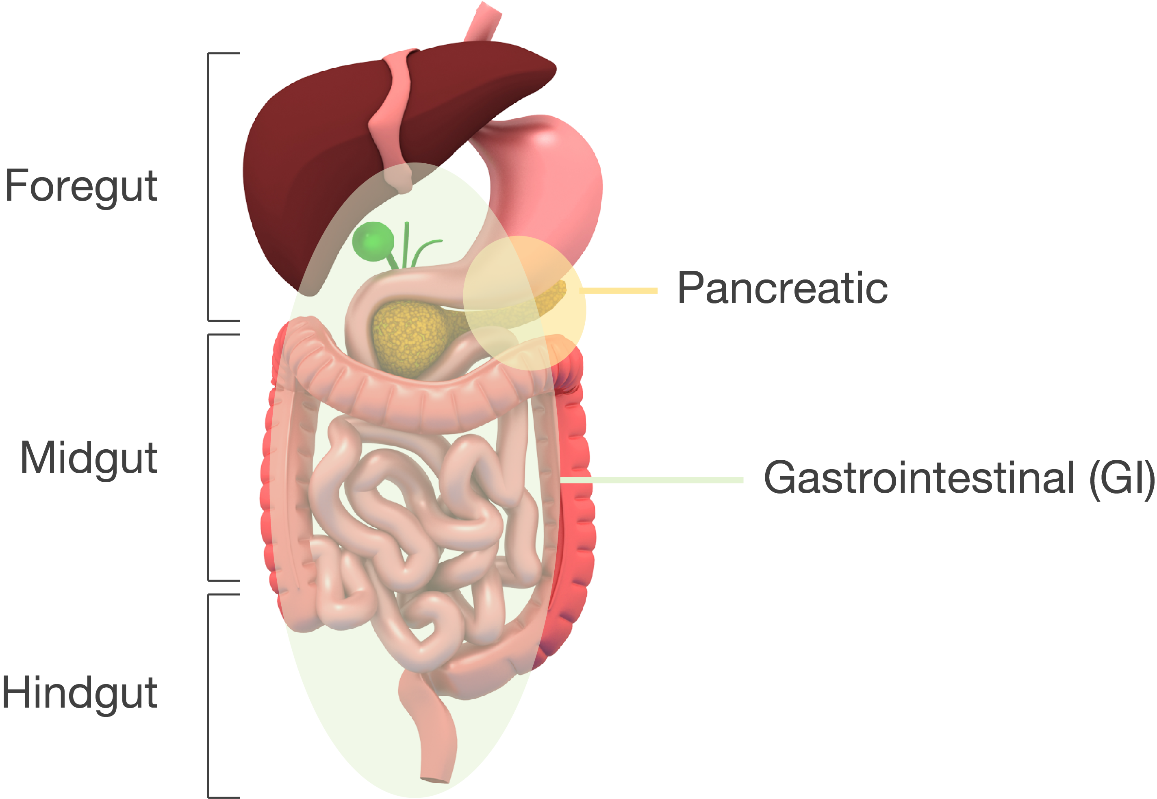
Gastroenteropancreatic neuroendocrine tumors (GEP-NETs): heterogeneous group of rare tumors¹
GEP-NETs consist of a spectrum of malignancies that can arise from neuroendocrine cells throughout the body¹
GEP-NETs may be grouped according to the embryologic origin of the primary site:¹
Foregut: stomach, duodenum, biliary system, and pancreas
Midgut: small bowel, appendix, cecum, and proximal colon
Hindgut: distal colon and rectum
1. Alexandraki, K.I.; Kaltsas, G. Gastroenteropancreatic neuroendocrine tumors: New insights in the diagnosis and therapy. Endocrine 2012, 41, 40–52.

Slide 11
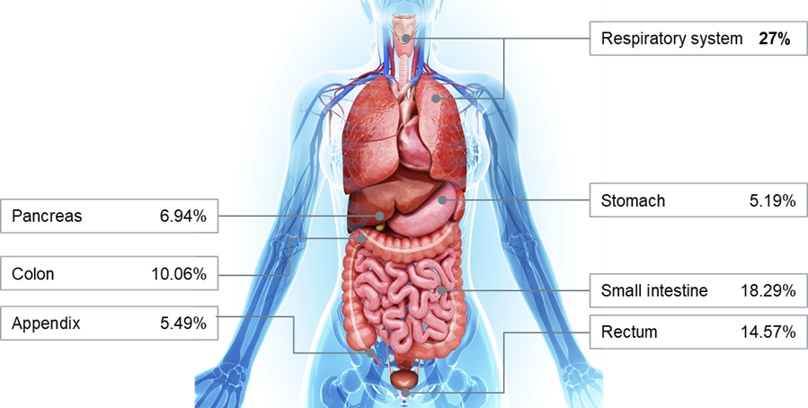
GI tract and pancreas — frequent localizations of NETs¹
Neuroendocrine cells are widely distributed throughout the body – NETs can appear in almost every organ or tissue¹
Adapted from JAMA Oncology
1. Dasari A, Shen C, Halperin D, et al. Trend in the incidence, prevalence, and survival outcomes in patients with neuroendocrine tumors in the United States. JAMA Oncol. 2017; April 2017.

Slide 12
NETs have historically been considered as rare tumors¹
Incidence has been increasing (>600% over the last 4 decades) and NETs are now the second most prevalent gastrointestinal cancer after colon cancer; more prevalent than pancreatic, gastric, esophageal or hepatic cancer or any two of these combined²
Adapted from JAMA Oncology
Adapted from JAMA Oncology
1. Alexandraki, K.I.; Kaltsas, G. Gastroenteropancreatic neuroendocrine tumors: New insights in the diagnosis and therapy. Endocrine 2012, 41, 40–52. 2. Dasari A, Shen C, Halperin D, et al. Trend in the incidence, prevalence, and survival outcomes in patients with neuroendocrine tumors in the United States. JAMA Oncol. 2017; April 2017.

Slide 13
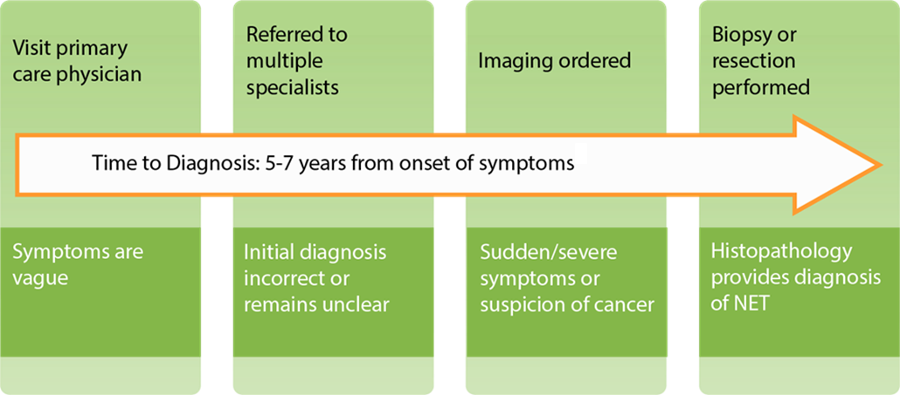
Most patients present with metastatic disease upon diagnosis¹
A majority of GEP-NETs are non-functioning (asymptomatic)¹
Metastatic disease is increasingly prevalent in GI-NETs and pNETs
At initial diagnosis, 60-70% of patients present with metastases¹
1. Alexandraki, K.I.; Kaltsas, G. Gastroenteropancreatic neuroendocrine tumors: New insights in the diagnosis and therapy. Endocrine 2012, 41, 40–52.

Slide 14
NETs pose high morbidity burden on patients¹
*not assessed due to small numbers
1. Dasari A, Shen C, Halperin D, et al. Trend in the incidence, prevalence, and survival outcomes in patients with neuroendocrine tumors in the United States. JAMA Oncol. 2017; April 2017.

Slide 15
Objectives
LUTATHERA® (lutetium Lu 177 dotatate) Important Safety Information
Gastroenteropancreatic Neuroendocrine Tumors (GEP-NETs)
LUTATHERA® Product Characteristics
Trials Supporting FDA-approval of LUTATHERA®
LUTATHERA® Regimen and Administration Procedure
Establishing LUTATHERA® at an institution
Support programs available for LUTATHERA®

Slide 16
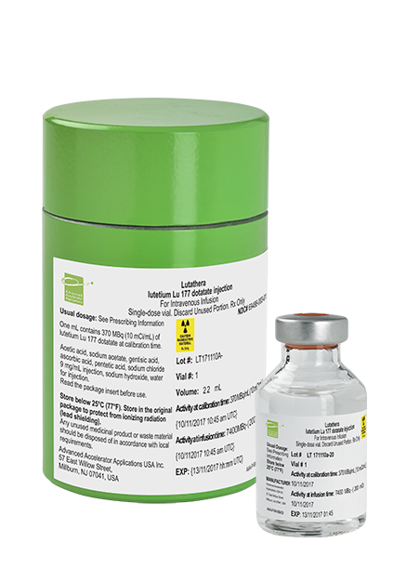
LUTATHERA® (lutetium Lu 177 dotatate) indication and contraindication
Indication:
LUTATHERA®, is indicated for the treatment of somatostatin receptor-positive gastroenteropancreatic neuroendocrine tumors (GEP-NETs) including foregut, midgut, and hindgut neuroendocrine tumors in adults.¹
Contraindications: None.¹
1. LUTATHERA® [prescribing information]. Millburn, NJ: Advanced Accelerator Applications USA, Inc.; January 2018.

Slide 17
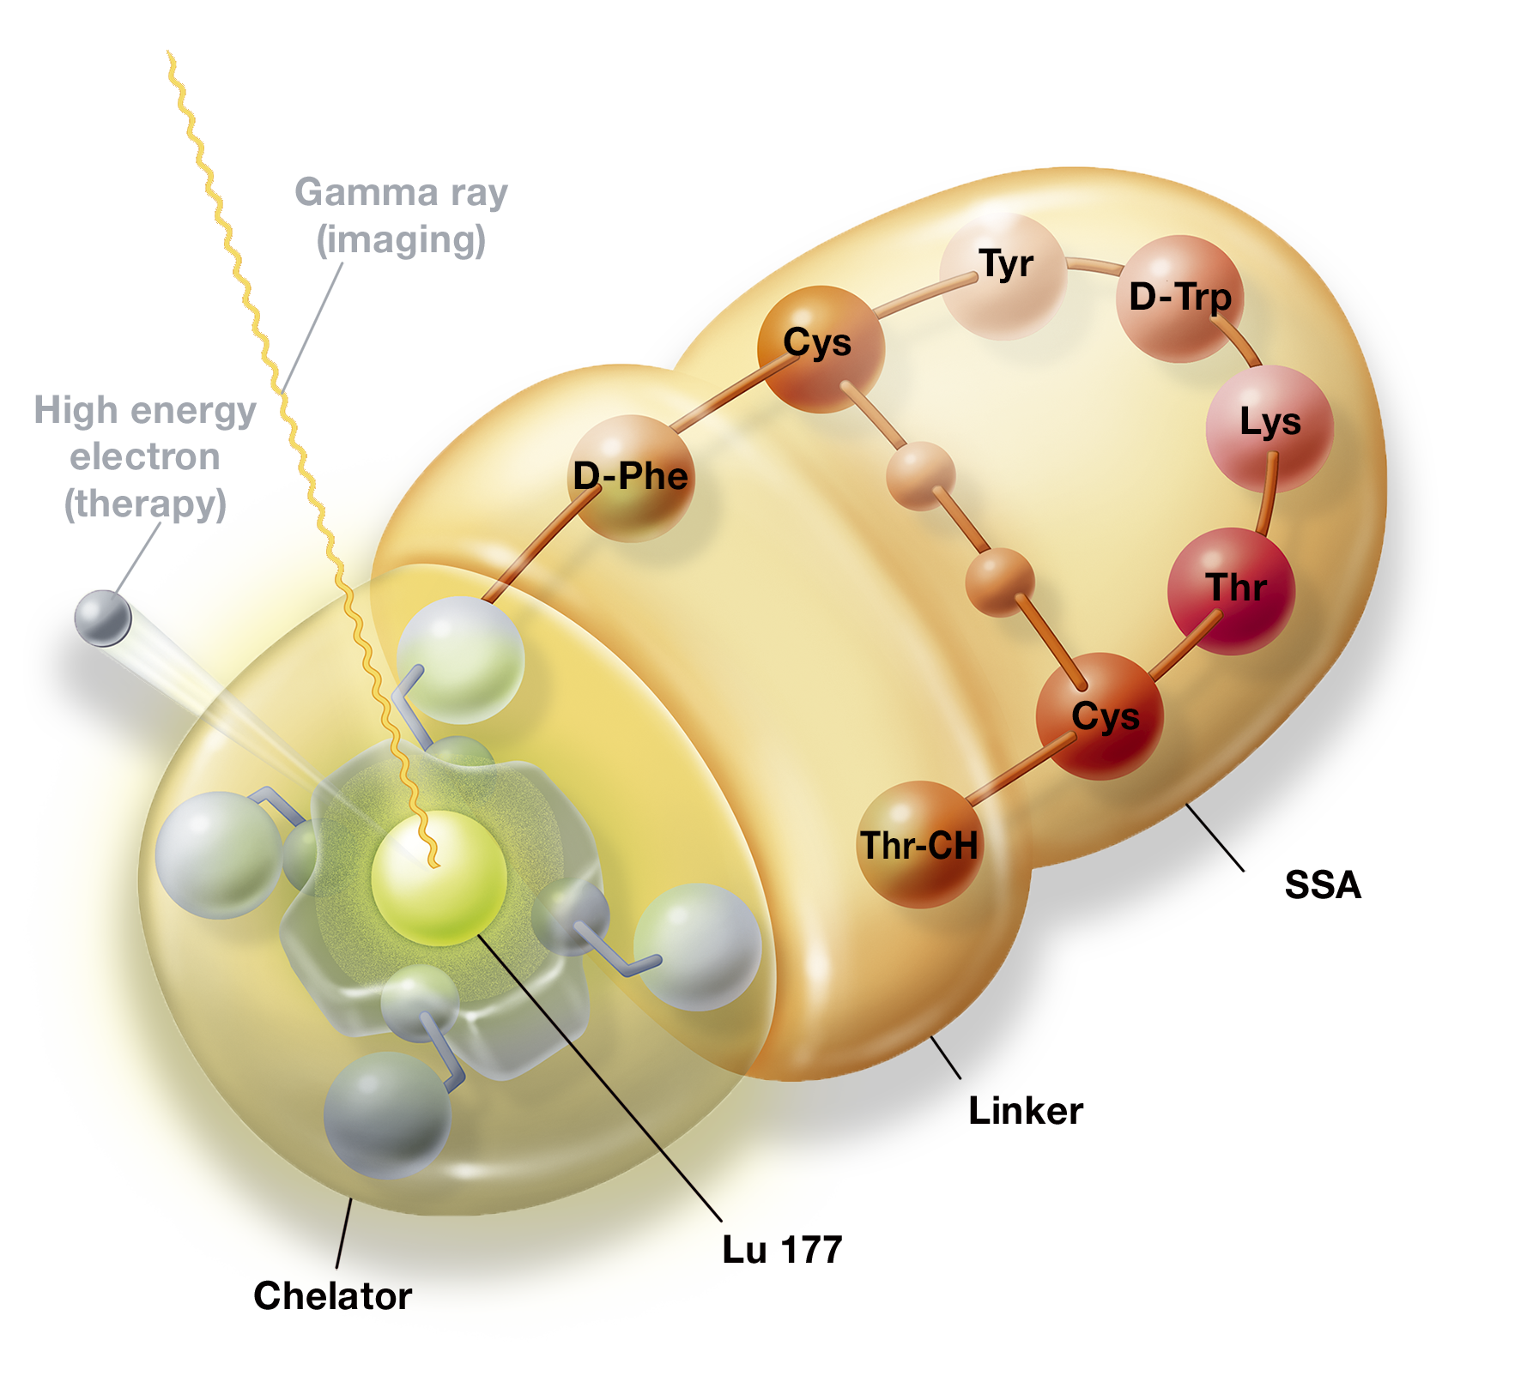
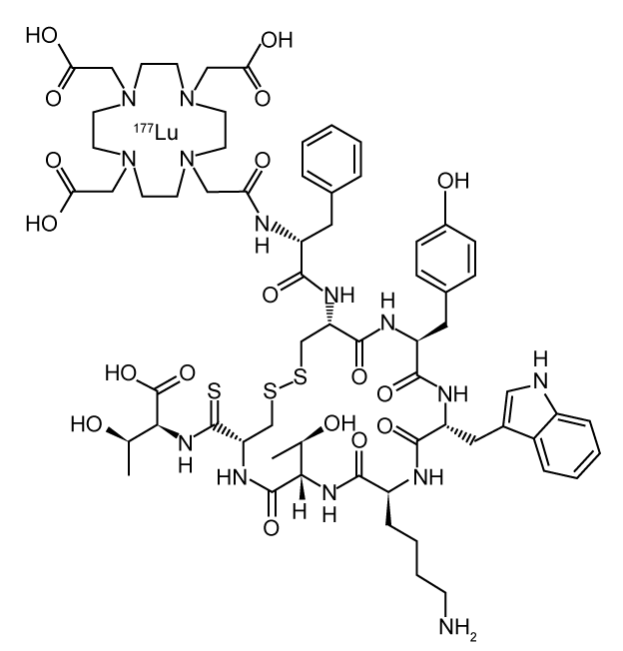
Peptide receptor radionuclide therapy (PRRT)
Chelator DOTA
Radionuclide Lu 177
Peptide octreotate
1. LUTATHERA® [prescribing information]. Millburn, NJ: Advanced Accelerator Applications USA, Inc.; January 2018.

Slide 18
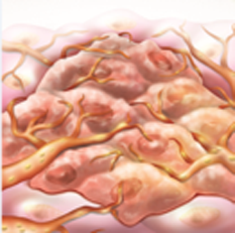
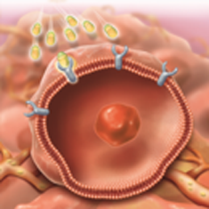
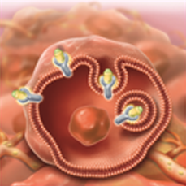
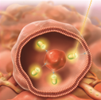
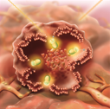
Mechanism of action¹
1
2
3
Infusion
Concentration in GEP-NET sites
Binding to somatostatin receptors (highest affinity for subtype 2 receptors)
4
5
6
Internalization into tumor cell
Irradiation of tumor cell
Radiation causes tumor cell death
1. LUTATHERA® [prescribing information]. Millburn, NJ: Advanced Accelerator Applications USA, Inc.; January 2018.

Slide 19
General precautions
LUTATHERA® (lutetium Lu 177 dotatate) is a radiopharmaceutical
Radiopharmaceuticals, including LUTATHERA®, should be used by or under the control of physicians who are qualified by specific training and experience in the safe use and handling of radiopharmaceuticals, and whose experience and training have been approved by the appropriate governmental agency authorized to license the use of radiopharmaceuticals.
Minimize radiation exposure during and after treatment with LUTATHERA® consistent with institutional good radiation safety practices and patient management procedures
Always follow the principal of ALARA (as low as reasonably achievable) when handling and administering LUTATHERA®
Use waterproof gloves and effective radiation shielding when handling LUTATHERA®
1. LUTATHERA® [prescribing information]. Millburn, NJ: Advanced Accelerator Applications USA, Inc.; January 2018.

Slide 20
Radioactive decay
Radiation | Energy (keV) | Iβ% | Iγ%
β⁻ | 176.5 | 12.2
β⁻ | 248.1 | 0.05
β⁻ | 384.9 | 9.1
β⁻ | 497.8 | 78.6
γ | 71.6 |  | 0.15
γ | 112.9 |  | 6.40
γ | 136.7 |  | 0.05
γ | 208.4 |  | 11.0
γ | 249.7 |  | 0.21
γ | 321.3 |  | 0.22
Lutetium (¹⁷⁷Lu) decays to stable hafnium (¹⁷⁷Hf) with a half-life of ~6.647 days, by emitting β⁻ radiation with a maximum energy of 0.498 MeV and photonic radiations (γ) of 0.208 MeV (11.0%) and 0.113 MeV (6.4%).
1. LUTATHERA® [prescribing information]. Millburn, NJ: Advanced Accelerator Applications USA, Inc.; January 2018.

Slide 21
Absorbed radiation doses to organs
 | Absorbed dose per activity (Gy/GBq) (N=20) |  | Calculated absorbed dose for 4 X 7.4 GBq (29.6 GBq cumulative activity) (Gy)
Organ | Mean | SD | Mean | SD
Adrenals | 0.037 | 0.016 | 1.1 | 0.5
Brain | 0.027 | 0.016 | 0.8 | 0.5
Breasts | 0.027 | 0.015 | 0.8 | 0.4
Gallbladder Wall | 0.042 | 0.019 | 1.2 | 0.6
Heart Wall | 0.032 | 0.015 | 0.9 | 0.4
Kidneys | 0.654 | 0.295 | 19.4 | 8.7
Liver* | 0.299 | 0.226 | 8.9 | 6.7
Lower Large Intestine Wall | 0.029 | 0.016 | 0.9 | 0.5
Lungs | 0.031 | 0.015 | 0.9 | 0.4
Muscle | 0.029 | 0.015 | 0.8 | 0.4
Osteogenic Cells | 0.151 | 0.268 | 4.5 | 7.9
Ovaries** | 0.031 | 0.013 | 0.9 | 0.4
Pancreas | 0.038 | 0.016 | 1.1 | 0.5
Red Marrow | 0.035 | 0.029 | 1.0 | 0.8
Skin | 0.027 | 0.015 | 0.8 | 0.4
Small Intestine | 0.031 | 0.015 | 0.9 | 0.5
Spleen | 0.846 | 0.804 | 25.1 | 23.8
Stomach Wall | 0.032 | 0.015 | 0.9 | 0.5
Testes*** | 0.026 | 0.018 | 0.8 | 0.5
Thymus | 0.028 | 0.015 | 0.8 | 0.5
Thyroid | 0.027 | 0.016 | 0.8 | 0.5
Total Body | 0.052 | 0.027 | 1.6 | 0.8
Upper Large Intestine Wall | 0.032 | 0.015 | 0.9 | 0.4
Urinary Bladder Wall | 0.437 | 0.176 | 12.8 | 5.3
Uterus | 0.032 | 0.013 | 1.0 | 0.4
*N=18 (two patients excluded because the liver absorbed dose was biased by the uptake of the liver metastases)
**N=9 (female patients only)
***N=11 (male patients only)
The maximum penetration in tissue is 2.2 mm and the mean penetration is 0.67 mm.
1. LUTATHERA® [prescribing information]. Millburn, NJ: Advanced Accelerator Applications USA, Inc.; January 2018.

Slide 22
Biodistribution and elimination
Within 4 hours after administration, LUTATHERA® (lutetium Lu 177 dotatate) distributes in kidneys, tumor lesions, liver, spleen, and in some patients, pituitary gland and thyroid¹
The co-administration of amino acids reduced the median radiation dose to the kidneys by 47% (34% to 59%) and increased the mean beta-phase blood clearance of LUTATHERA® by 36%.
Primarily eliminated renally with cumulative excretion of¹:
Time After Administration | % Excretion
< 5 hours | 44
< 24 hours | 58
< 48 hours | 65
< 14 days | >99
1. LUTATHERA® [prescribing information]. Millburn, NJ: Advanced Accelerator Applications USA, Inc.; January 2018.

Slide 23
Objectives
LUTATHERA® (lutetium Lu 177 dotatate) Important Safety Information
Gastroenteropancreatic Neuroendocrine Tumors (GEP-NETs)
LUTATHERA® Product Characteristics
Trials Supporting FDA-approval of LUTATHERA®
LUTATHERA® Regimen and Administration Procedure
Establishing LUTATHERA® at an institution
Support programs available for LUTATHERA®

Slide 24
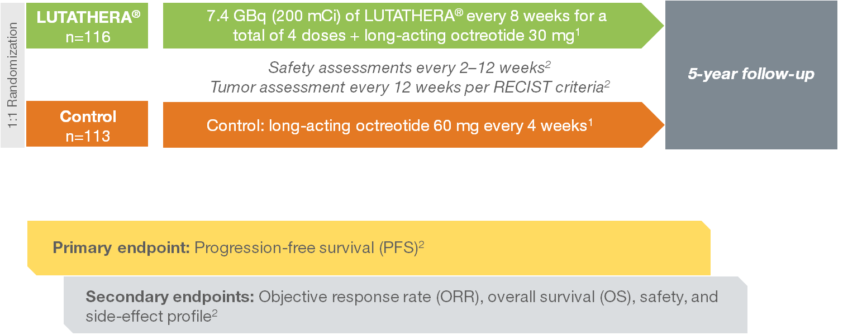
NETTER-1: international, multicenter, randomized, comparator-controlled, parallel-group phase III study¹
1. LUTATHERA® [prescribing information]. Millburn, NJ: Advanced Accelerator Applications USA, Inc.; January 2018.
2. Strosberg J, El-Haddad G, Wolin E, et al. Phase 3 Trial of (177)Lu-Dotatate for Midgut Neuroendocrine Tumors. N Engl J Med. 2017;376(2):125-135.

Slide 25
NETTER-1: inclusion and exclusion criteria¹
Inclusion criteria
Exclusion criteria
Patients with midgut NET that had metastasized or were locally advanced, that were inoperable, and had progressed during treatment with octreotide LAR
Karnofsky score ≥60
Tumor with well-differentiated histologic features, as defined by the Ki67 index
Somatostatin receptors present on all target lesions
Serum creatinine level ≥150 μmol/L or creatinine clearance of <50 mL/min
Hemoglobin level <8.0 g/dL
White-cell count <2000/mm³
Platelet count <75,000/mm³
Total bilirubin level >3x the upper limit of normal range
Serum albumin >3.0/dL, unless the prothrombin time value was within normal range
Treatment with >30 mg octreotide LAR within 12 weeks before randomization
Peptide receptor radionuclide therapy (PRRT) at any time before randomization
Any surgery, liver-directed transarterial therapy, or chemotherapy within 12 weeks before randomization
1. Strosberg J, El-Haddad G, Wolin E, et al. Phase 3 Trial of (177)Lu-Dotatate for Midgut Neuroendocrine Tumors. N Engl J Med. 2017;376(2):125-135.

Slide 26
NETTER-1: well-balanced patient characteristics¹
Characteristic | LUTATHERA® (n=116) | Control (n=113)
Age, mean ± standard deviation | 63 years ± 9 | 64 years ± 10
Median time since diagnosis, years | 3.8 | 4.8
Primary tumor site, n (%) Ileum Small intestine, not otherwise specified Midgut, not otherwise specified Jejunum Right colon Appendix | 86 (74) 11 (9) 9 (8) 6 (5) 3 (3) 1 (1) | 82 (73) 12 (11) 7 (6) 9 (8) 1 (1) 2 (2)
Site of metastasis, n (%) Liver Lymph nodes Mesentery Bone Other Peritoneum Lungs Ovaries | 97 (84) 77 (66) 17 (15) 13 (11) 15 (13) 7 (6) 11 (9) 1 (1) | 94 (83) 65 (58) 8 (7) 12 (11) 10 (9) 10 (9) 5 (4) 9 (8)
Somatostatin receptor scintigraphy, Krenning scale, n (%) Grade 2 Grade 3 Grade 4 | 11 (9) 34 (29) 71 (61) | 12 (11) 34 (30) 67 (59)
1. Strosberg J, El-Haddad G, Wolin E, et al. Phase 3 Trial of (177)Lu-Dotatate for Midgut Neuroendocrine Tumors. N Engl J Med. 2017;376(2):125-135.

Slide 27
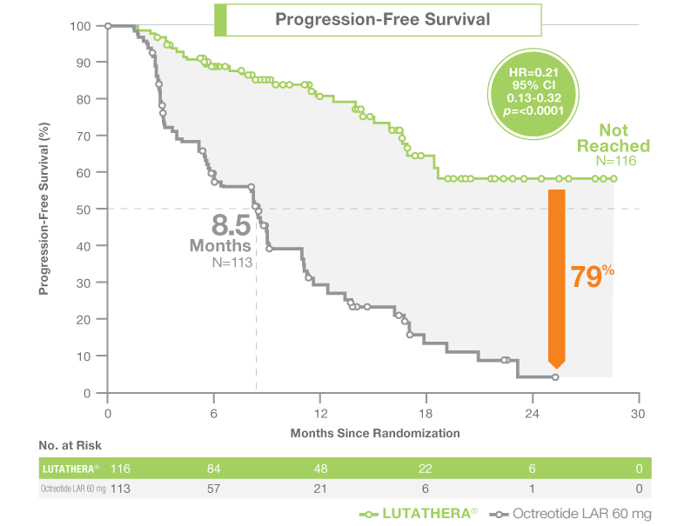
Markedly longer progression-free survival (PFS)¹
Median PFS for LUTATHERA® (lutetium Lu 177 dotatate) was not reached
Median PFS for long-acting octreotide 60 mg was 8.5 months
PFS events
LUTATHERA®= 27
Long-acting octreotide 60 mg = 78
Indicates a 79% risk reduction for disease progression or death (HR 0.21 [95% CI, 0.13, 0.32], P<0.0001)¹
1. LUTATHERA® [prescribing information]. Millburn, NJ: Advanced Accelerator Applications USA, Inc.; January 2018.

Slide 28
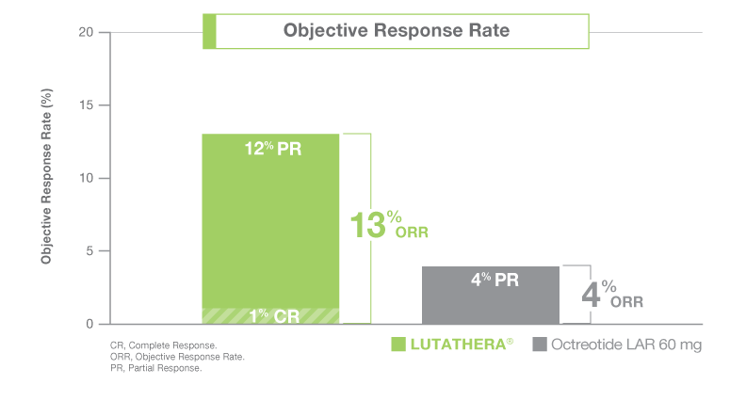
LUTATHERA® (lutetium Lu 177 dotatate) demonstrated 3X greater ORR than long-acting octreotide 60 mg (P=0.0148)¹
1. LUTATHERA® [prescribing information]. Millburn, NJ: Advanced Accelerator Applications USA, Inc.; January 2018.

Slide 29
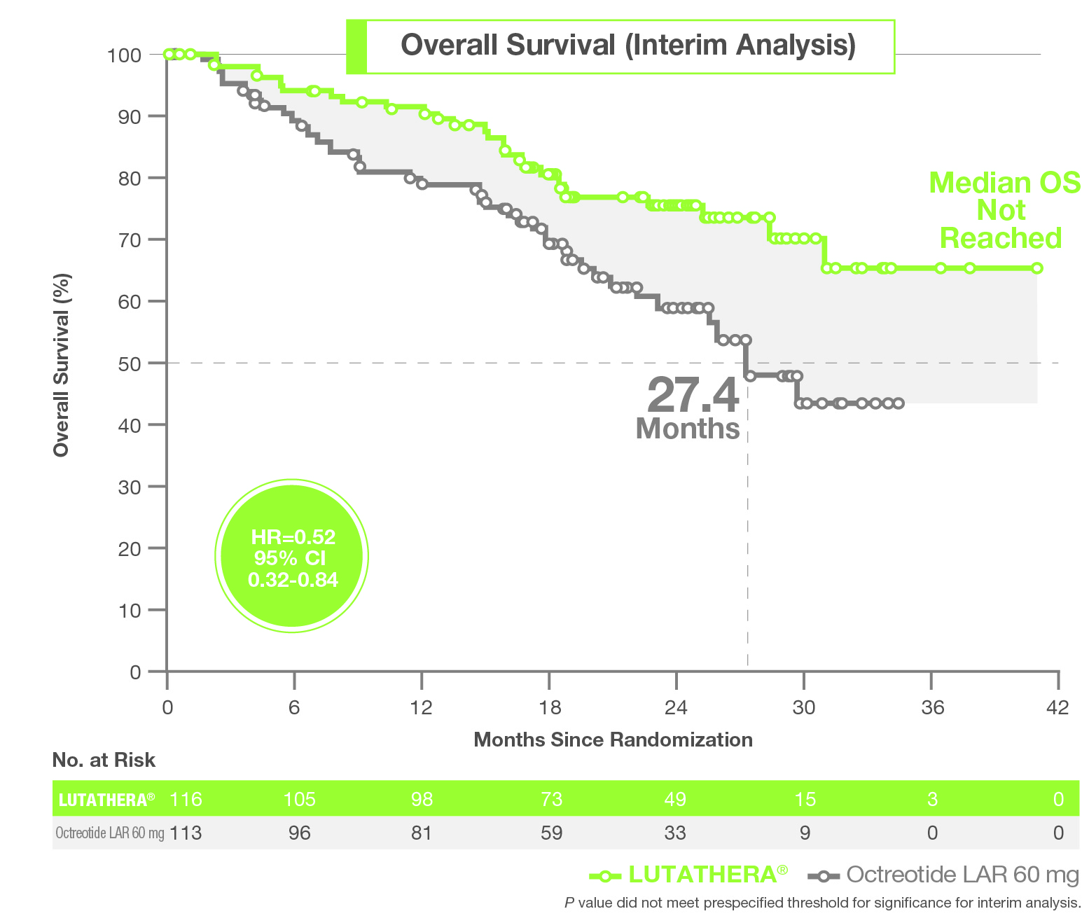
Preliminary evidence suggests an overall survival (OS) benefit¹
Updated 2016 interim overall survival analysis suggests longer overall survival with LUTATHERA® (lutetium lu 177 dotatate) vs long-acting octreotide 60 mg
48% reduction in estimated risk of death (HR 0.52; 95% CI, 0.32, 0.84)¹
LUTATHERA® = 27 deaths
Long-acting octreotide 60 mg = 43 deaths
The final analysis of OS is planned after 158 cumulative deaths or 5 years from last patient randomization²
1. LUTATHERA® [prescribing information]. Millburn, NJ: Advanced Accelerator Applications USA, Inc.; January 2018.
2. Strosberg J, El-Haddad G, Wolin E, et al. Phase 3 Trial of (177)Lu-Dotatate for Midgut Neuroendocrine Tumors. N Engl J Med. 2017;376(2):125-135.

Slide 30
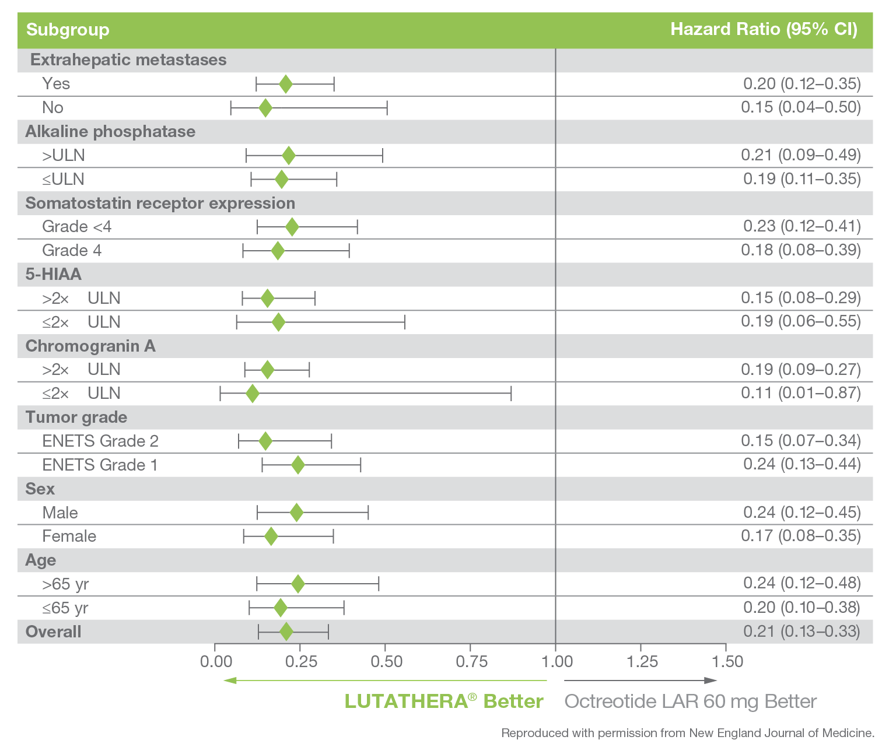
Consistent treatment benefits seen across all prespecified subpopulations¹
Consistent progression-free survival benefits with LUTATHERA® (lutetium Lu 177 dotatate) were observed irrespective of stratification and prognostic factors, including:
Levels of radiotracer uptake on somatostatin receptor scintigraphy (SRS)
Tumor Grade
Age
Gender
Tumor marker levels
1. Strosberg J, El-Haddad G, Wolin E, et al. Phase 3 Trial of (177)Lu-Dotatate for Midgut Neuroendocrine Tumors. N Engl J Med. 2017;376(2):125-135.

Slide 31
Acute toxic side effects¹
 | LUTATHERA® + long-acting octreotide 30 mg N=111 |  | Long-Acting octreotide 60 mg N=112
Adverse Reactions¹ | All Grades % | Grades 3-4% | All Grades % | Grades 3-4%
Cardiac disorders
Atrial fibrillation | 5 | 1 | 0 | 0
Gastrointestinal disorders
Nausea | 65 | 5 | 12 | 2
Vomiting | 53 | 7 | 9 | 0
Abdominal pain | 26 | 3 | 19 | 3
Diarrhea | 26 | 3 | 18 | 1
Constipation | 10 | 0 | 5 | 0
General disorders
Fatigue | 38 | 1 | 26 | 2
Peripheral edema | 16 | 0 | 9 | 1
Pyrexia | 8 | 0 | 3 | 0
Metabolism and nutrition disorders
Decreased appetite | 21 | 0 | 11 | 3
Musculoskeletal and connective tissue disorders
Back pain | 13 | 2 | 10 | 0
Pain in extremity | 11 | 0 | 5 | 0
Myalgia | 5 | 0 | 0 | 0
Neck pain | 5 | 0 | 0 | 0
Nervous system disorders
Headache | 17 | 0 | 5 | 0
Dizziness | 17 | 0 | 8 | 0
Dysgeusia | 8 | 0 | 2 | 0
Psychiatric disorders
Anxiety | 12 | 1 | 5 | 0
Renal and urinary disorders
Renal failure | 12 | 3 | 3 | 1
Radiation-related urinary tract toxicity | 8 | 0 | 3 | 0
Respiratory, thoracic, and mediastinal disorders
Cough | 11 | 1 | 6 | 0
Skin and subcutaneous tissue disorders
Alopecia | 12 | 0 | 2 | 0
Vascular disorders
Flushing | 14 | 1 | 9 | 0
Hypotension | 12 | 2 | 7 | 2
The most common Grade 3-4 adverse reactions observed in LUTATHERA® clinical trials were
lymphopenia (44%)
increased GGT (20%)
vomiting (7%)
nausea (5%)
elevated AST (5%)
increased ALT (4%)
hyperglycemia (4%)
hypokalemia (4%)
Patient discontinuation of LUTATHERA®:
5 patients discontinued for renal-related events
4 patients discontinued for hematological toxicities
¹ National Cancer Institute Common Terminology Criteria for Adverse Events (CTCAE) version 4.03. Only displays laboratory abnormalities occurring at a higher incidence in Lu 177 dotatate-treated patient s [between arm difference of ≥5% (all grades) or ≥2% (grades 3-4)]
1. LUTATHERA® [prescribing information]. Millburn, NJ: Advanced Accelerator Applications USA, Inc.; January 2018.

Slide 32
Laboratory abnormalities¹
 | LUTATHERA® + long-acting octreotide 30 mg N=111 |  | Long-Acting octreotide 60 mg N=112
Lab Abnormality^{*,1} | All Grades % | Grades 3-4% | All Grades % | Grades 3-4%
Hematology
Lymphopenia | 90 | 44 | 39 | 4
Anemia | 81 | 0 | 54 | 1
Leukopenia | 55 | 2 | 20 | 0
Thrombocytopenia | 53 | 1 | 17 | 0
Neutropenia | 26 | 3 | 11 | 0
Renal/Metabolic
Creatinine increased | 85 | 1 | 73 | 0
Hyperglycemia | 82 | 4 | 67 | 2
Hyperuricemia | 34 | 6 | 29 | 6
Hypocalcemia | 32 | 0 | 14 | 0
Hypokalemia | 26 | 4 | 21 | 2
Hyperkalemia | 19 | 0 | 11 | 0
Hypernatremia | 17 | 0 | 7 | 0
Hypoglycemia | 15 | 0 | 8 | 0
Nervous system disorders
GGT increased | 66 | 20 | 67 | 16
Alkaline phosphatase increased | 65 | 5 | 54 | 9
AST increased | 50 | 5 | 35 | 0
ALT increased | 43 | 4 | 34 | 0
Blood bilirubin increased | 30 | 2 | 28 | 0
* Values are worst grade observed after randomization
¹ National Cancer Institute Common Terminology Criteria for Adverse Events (CTCAE) version 4.03. Only displays laboratory abnormalities occurring at a higher incidence in Lu 177 dotatate-treated patient s [between arm difference of ≥5% (all grades) or ≥2% (grades 3-4)]
1. LUTATHERA® [prescribing information]. Millburn, NJ: Advanced Accelerator Applications USA, Inc.; January 2018.

Slide 33
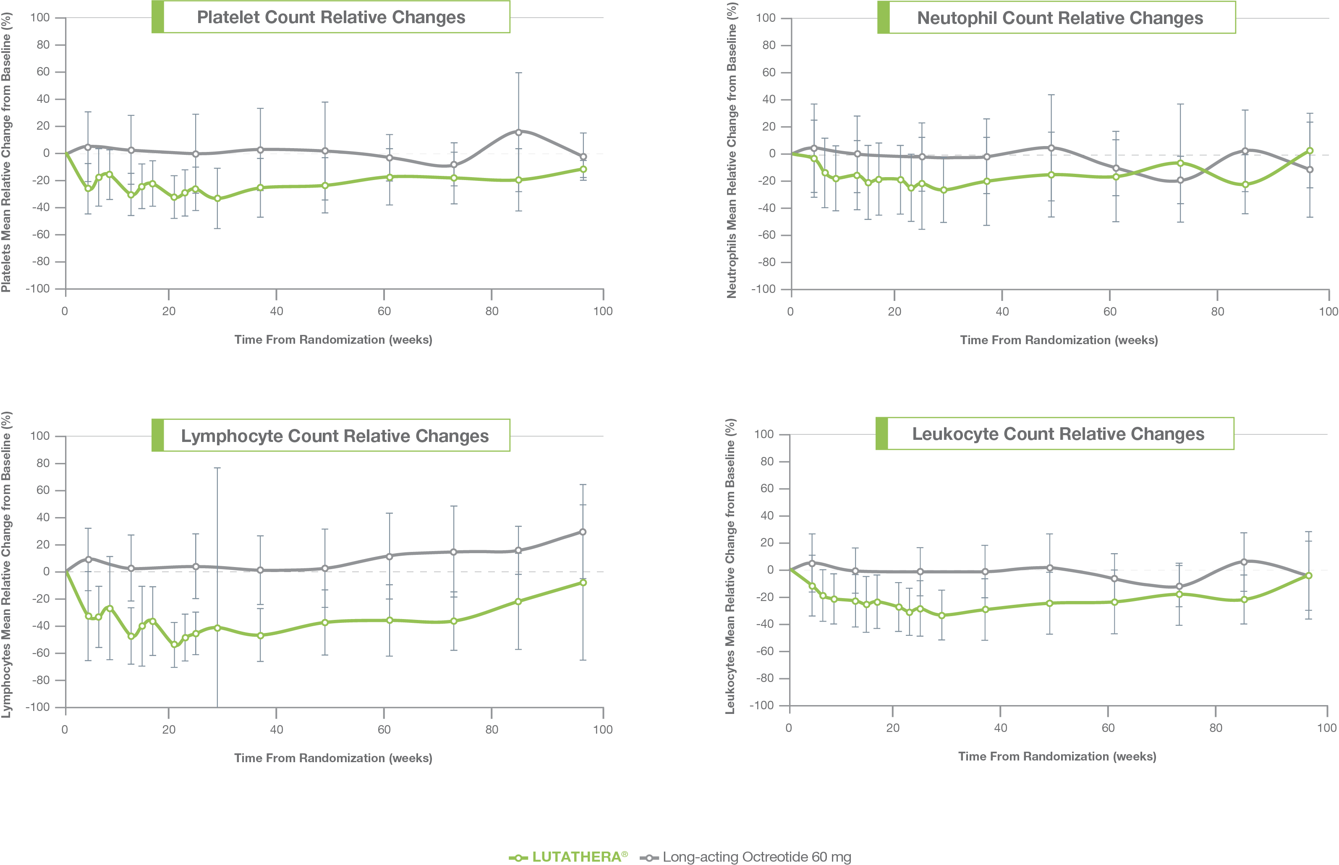
Hematologic events were transient¹
1. Strosberg J, El-Haddad G, Wolin E, et al. Phase 3 Trial of (177)Lu-Dotatate for Midgut Neuroendocrine Tumors. N Engl J Med. 2017;376(2):125-135.

Slide 34
ERASMUS: retrospective, single-center, single-arm, open-label, phase I/II study in patients with GEP- and other NETs^{1,2}
Outcomes of interest:
PFS
OS
TTP
ORR
LUTATHERA®
n=1,214
Treatment every 6-10 weeks Up to a cumulative dose of 750-800 mCi
Safety assessments after each cycle
Tumor assessment according to RECIST criteria within 3 months before first therapy and at every follow-up
ORR: objective response rate; OS: overall survival; PFS: progression-free survival; TTP: time to progression
1. LUTATHERA® [prescribing information]. Millburn, NJ: Advanced Accelerator Applications USA, Inc.; January 2018.
2. Brabander T, et al. Clin Cancer Res. 2017;23(16):4617-4624.

Slide 35
Patient Selection^{1,2}
Patients treated with LUTATHERA® (lutetium Lu 177 dotatate) n=1214
Efficacy analysis
Safety analysis
Assessed per RECIST criteria n=601
Not assessed per RECIST criteria n=613
Safety analysis subset (Dutch patients) n=811
Not assessed (foreign patients) n=403
Other tumor types
n=241
GEP-NET patients
n=360
Treated with ≥600 mCi LUTATHERA® n=657
Treated with <600 mCi LUTATHERA®
N=154
1. LUTATHERA® [prescribing information]. Millburn, NJ: Advanced Accelerator Applications USA, Inc.; January 2018.
2. Brabander T, et al. Clin Cancer Res. 2017;23(16):4617-4624.

Slide 36
Efficacy Analysis
The investigator assessed objective response rate (ORR) was 16% (95% CI 13, 20) in the 360 patients with GEP-NETs¹
Median duration of response in the 58 responding patients was 35 months (95% CI: 17, 38)
Investigator Assessed Response Rate (%)
16
1. LUTATHERA® [prescribing information]. Millburn, NJ: Advanced Accelerator Applications USA, Inc.; January 2018.

Slide 37
Safety Analysis¹
With a median follow-up time of more than 4 years, the following rates of serious adverse reactions were reported:
Percentage of Patients (%)
1. LUTATHERA® [prescribing information]. Millburn, NJ: Advanced Accelerator Applications USA, Inc.; January 2018.

Slide 38
Objectives
LUTATHERA® (lutetium Lu 177 dotatate) Important Safety Information
Gastroenteropancreatic Neuroendocrine Tumors (GEP-NETs)
LUTATHERA® Product Characteristics
Trials Supporting FDA-approval of LUTATHERA®
LUTATHERA® Regimen and Administration Procedure
Establishing LUTATHERA® at an institution
Support programs available for LUTATHERA®

Slide 39
Treatment Regimen¹
LUTATHERA® (lutetium Lu 177 dotatate) 7.4 GBq (200 mCi) is administered as an intravenous infusion over 30-40 minutes every 8 weeks for a total of 4 doses (4 x 200 mCi = 800 mCi)
In case of toxicity: The interval between each infusion may be extended up to 16 weeks
1. LUTATHERA® [prescribing information]. Millburn, NJ: Advanced Accelerator Applications USA, Inc.; January 2018.

Slide 40
Somatostatin analogs
Do not administer long-acting octreotide within 4 weeks of each LUTATHERA® (lutetium Lu 177 dotatate) dose
Short-acting octreotide may be given for symptomatic management during LUTATHERA® treatment, but must be withheld for at least 24 hours prior to each LUTATHERA® dose
During LUTATHERA® treatment, administer long-acting octreotide 30 mg intramuscularly between 4 to 24 hours after each LUTATHERA® dose.
After completing the LUTATHERA® 4-dose regimen, continue long-acting octreotide 30 mg every 4 weeks until disease progression or for up to 18 months following treatment initiation
1. LUTATHERA® [prescribing information]. Millburn, NJ: Advanced Accelerator Applications USA, Inc.; January 2018.

Slide 41
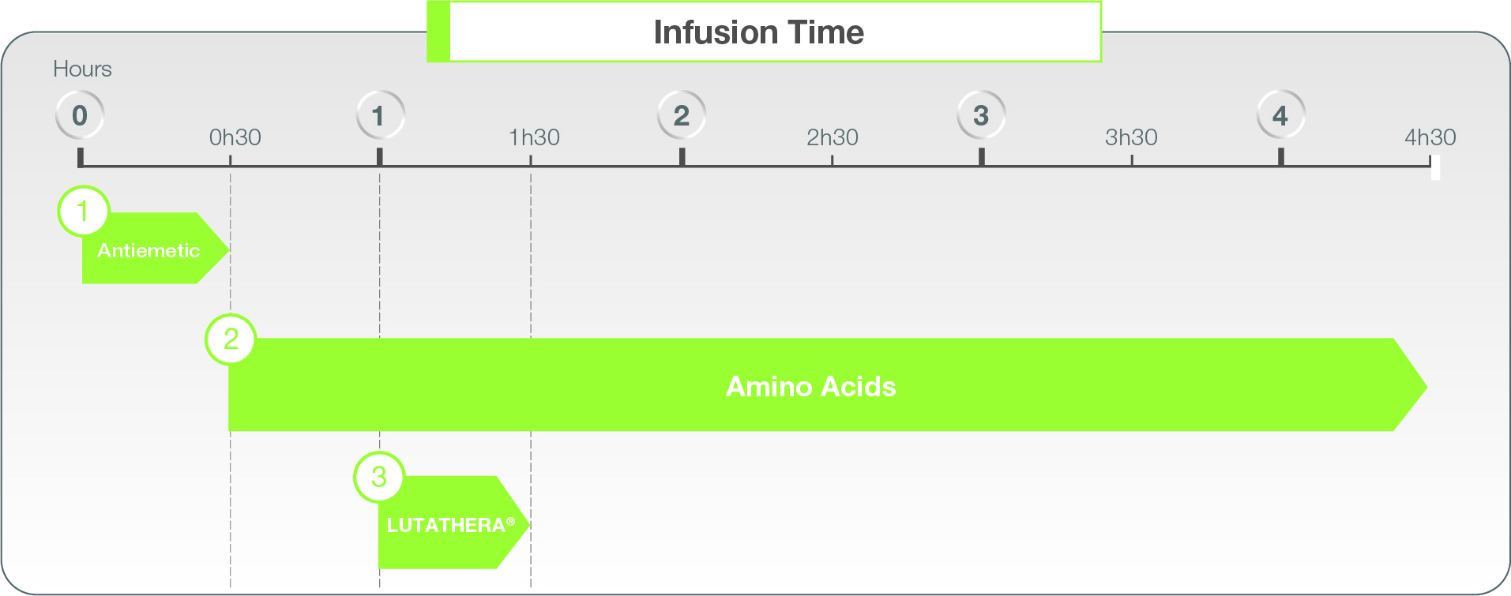
Administration timeline¹
1
Pre-Treatment Antiemetic: To help address treatment-related nausea and vomiting, an antiemetic drug should be given 30 minutes before the amino acid solution infusion.
Concomitant Amino Acid Infusion: An amino acid solution containing sufficient amounts of L-lysine and L-arginine is required for renal protection. This infusion must start 30 minutes before the start of LUTATHERA® (lutetium Lu 177 dotatate) infusion and must be continued during, and for at least 3 hours after LUTATHERA® infusion.
LUTATHERA®: Administer as an intravenous infusion over 30-40 minutes. 50 mL/hour to 100 mL/hour for 5 to 10 mins; 200 mL/hour to 300 mL/hour for the following 25 to 30 mins
2
3
1. LUTATHERA® [prescribing information]. Millburn, NJ: Advanced Accelerator Applications USA, Inc.; January 2018.

Slide 42
Concomitant medications¹
Composition of the recommended amino acid solution:
Amino acid infusion rate should be determined by the treating physician, however 1/8 of the amino acid should be administered prior to start of LUTATHERA® (lutetium Lu 177 dotatate). The dose of the amino acid should not be decreased if the LUTATHERA® dose is reduced.
No specific mechanism of action or mode of administration for the antiemetic is listed in the LUTATHERA® Prescribing Information.
Antiemetic chosen should be determined by the treating physician
Item | Specification
Lysine content | Between 18 g and 24 g
Arginine content | Between 18 g and 24 g
Volume | 1.5 L to 2.2 L
Osmolarity | < 1050 mOsmol
1. LUTATHERA® [prescribing information]. Millburn, NJ: Advanced Accelerator Applications USA, Inc.; January 2018.

Slide 43
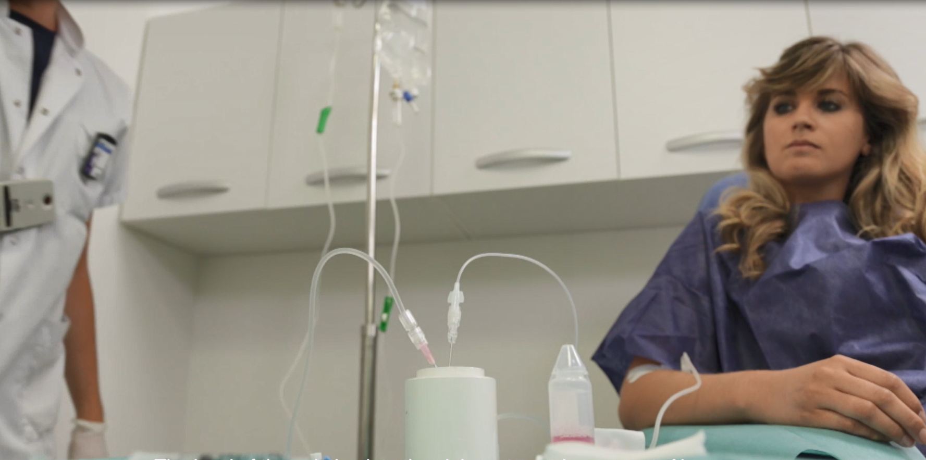
Administration method
The “push” infusion method is the recommended infusion method as per the LUTATHERA® (lutetium Lu 177 dotatate) Prescribing Information.
Principle: the flow of saline solution into the LUTATHERA® induces pressure which “pushes” the radiopharmaceutical into the intravenous infusion catheter of the patient
This infusion method is the same method utilized in the phase 3 trial for LUTATHERA® and during the US Expanded Access Program
LUTATHERA® must not be infused as an intravenous bolus¹
1. LUTATHERA® [prescribing information]. Millburn, NJ: Advanced Accelerator Applications USA, Inc.; January 2018.

Slide 44
Administration materials¹
One (1) or two (2) infusion poles
One (1) 9 cm, 18 gauge needle
One (1) 2.5 cm, 20 gauge needle
Two (2) intravenous infusion sets with a clamp to regulate or stop the flow
Two (2) infusion pumps with associated tubing, if using a pump to regulate or stop the flow
Two (2) IV catheters, if infusing amino acids and LUTATHERA® through separate venous access
One (1) 3-way valve, if infusing amino acids and LUTATHERA® through the same venous access
One (1) sterile male to male tubing line
A pair of tongs for LUTATHERA® vial handling
Calibrated radioactivity measurement system
Medications and supplies to address potential neuroendocrine hormonal crisis*
One (1) 9mg/ml NaCl, 500 ml saline solution infusion bag
Antiemetic
Recommended amino acids solution
LUTATHERA® original vial and lead shielding
1. LUTATHERA® [prescribing information]. Millburn, NJ: Advanced Accelerator Applications USA, Inc.; January 2018.

Slide 45
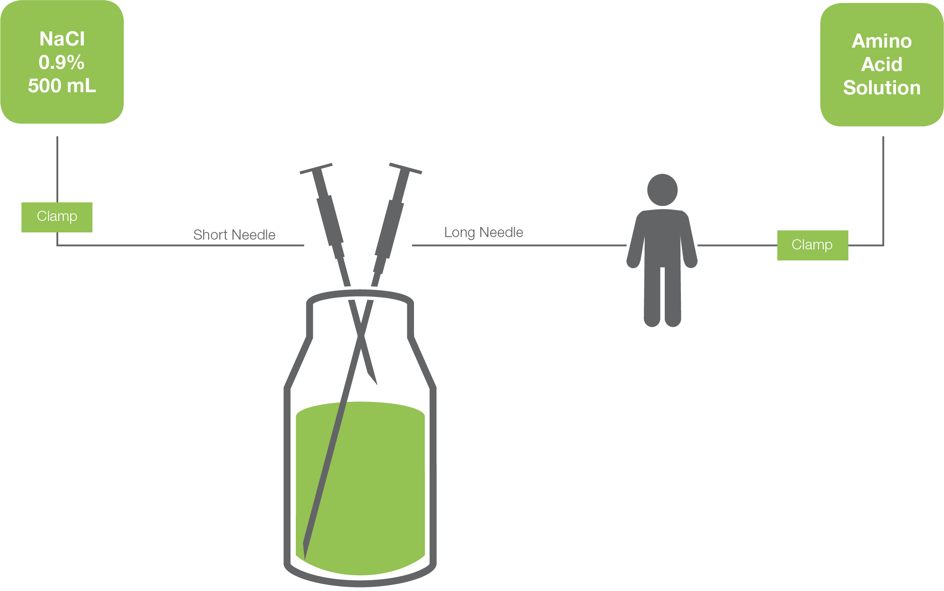
Administration set-up¹
1
3
Insert the short needle into the vial
The short needle must NOT touch the solution inside of the vial
Insert the long needle into the vial
The long needle must touch and be secured to the bottom of the vial during the entire infusion
2
4
Connect the short needle to the sodium chloride solution
Do not allow sterile sodium chloride to flow into the vial prior to the start of the infusion
Connect the long needle to the patient male-to-male tubing and catheter.
Tubing should be prefilled with sodium chloride
Clamps may be used to regulate the flow of both the sodium chloride solution and the amino acid. Alternatively, pumps may also be utilized.
1. LUTATHERA® [prescribing information]. Millburn, NJ: Advanced Accelerator Applications USA, Inc.; January 2018.

Slide 46
Completing the infusion¹
Disconnect the vial from the long needle line and clamp the saline line once the level of radioactivity is stable for at least 5 minutes
Follow the infusion with an intravenous flush of 25 mL of 0.9% sterile sodium chloride
Dispose of any unused medicinal product or waste material in accordance with local and federal laws
Patients should be discharged only when radiation exposure to third parties does not exceed regulatory threshold; usually 5 mSv (0.5 rem)
1
2
3
4
1. LUTATHERA® [prescribing information]. Millburn, NJ: Advanced Accelerator Applications USA, Inc.; January 2018.

Slide 47
General 24-hour patient treatment timeline
Time | Task | Responsible Party
8:00 AM | Patient check in for treatment | Nursing Staff
8:15-9:00 AM | Assessment, expectations of the day, orientation to room, IV placement, posttreatment instructions given, and LUTATHERA® (lutetium Lu 177 dotatate) and medication prep | Nursing Staff
9:00-9:45 AM | Antiemetic administration and start of amino acids infusion | Nursing Staff
10:15 AM | Prep for LUTATHERA® (void, positioning, time out, and monitoring) | Nuclear Medicine/ Radiation Oncology
11:00-11:15 AM | Completion of LUTATHERA® and flush | Nuclear Medicine/ Radiation Oncology
11:15-16:00 PM | Symptom monitoring and management, amino acid titration, antiemetics as needed, and completion of amino acids infusion | Nursing Staff
16:00-17:00 PM | Discharge instruction review, IV removal | Discharge Staff

Slide 48
Objectives
LUTATHERA® (lutetium Lu 177 dotatate) Important Safety Information
Gastroenteropancreatic Neuroendocrine Tumors (GEP-NETs)
LUTATHERA® Product Characteristics
Trials Supporting FDA-approval of LUTATHERA®
LUTATHERA® Regimen and Administration Procedure
Establishing LUTATHERA® at an institution
Support programs available for LUTATHERA®

Slide 49
Institution specific steps and approvals
Institution specific steps and approvals may be required prior to establishing a LUTATHERA® (lutetium Lu 177 dotatate) program. These steps may or may not apply to your institution; speak with your institution staff to confirm this
Appropriate time should be allocated for each of these steps:
EHR Build
Radiation Safety
Value Committee
Purchasing Team
Formulary Committee
Tumor Board

Slide 50
Radioactive materials license for Lu 177
Radioactivity considerations:
Lu 177 > 99.94% of total activity
Half-life = 6.647 days
Lu 177m < 0.05% of total activity
Half-life = 160 days
Licensing requirements for Lu 177:
Licensee is authorized to possess and use unsealed byproduct material for which a written directive is required (35.300)
Licensee has authority to possess Lu 177m
Not listed in exempt quantities limit in 10 CFR 30.71 Schedule B therefore
Broad scope licenses with no half-life limitation may be OK
Narrow scope licenses with specific line item (Lu 177m) may be OK
Waste accumulation needs to be taken into consideration
Decay-in-storage practices are similar to isotopes of analogous half-lives

Slide 51
Treatment room and bathroom
Absorbent drapes should be used to cover vulnerable areas in the patient room and bathroom. This might include certain areas of the floor and toilet.
Patient should be provided with access to an isolated bathroom unavailable to the general public as LUTATHERA® (lutetium Lu 177 dotatate) is excreted in the urine, which will therefore contain radioactive material.
Vomit may be considered as radioactive waste, if it includes bile. Appropriate precautions should be taken.
Image reproduced with permission from Rocky Mountain Cancer Centers
1. LUTATHERA® [prescribing information]. Millburn, NJ: Advanced Accelerator Applications USA, Inc.; January 2018.

Slide 52
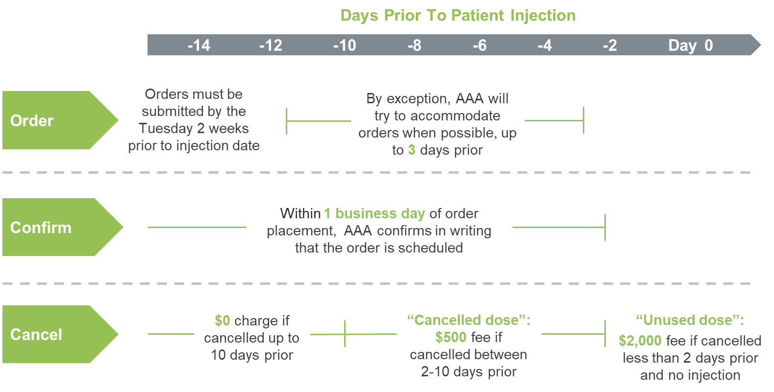
Ordering
Orders are initiated by sending a completed LUTATHERA® (lutetium Lu 177 dotatate) order form to AAA Customer service at orders-US@adacap.com
*Unused dose fees will be waived in cases where the patient is no longer eligible for treatment due to pretreatment testing

Slide 53
Shipping
Day A Manufacture and International Shipment
Day B Hospital Shipment
Day C
Patient Infusion
Production ends in Italy
Flight departs from Milan
Flight arrives in the US
FedEx cut-off time
Planned arrival at the institution
Shipment arrival, if delayed
Patient Injection
*All times listed are EST
Above is an example of a LUTATHERA® (lutetium Lu 177 dotatate) shipping timeline. LUTATHERA® is manufactured and shipped from Ivrea, Italy, to the location where the infusion will take place.
The times listed above are estimated and subject to change based upon potential delays from US Customs and Border Protection or other shipping protocols, which may be outside of AAA’s control. Delays may affect LUTATHERA® delivery and calibration.

Slide 54
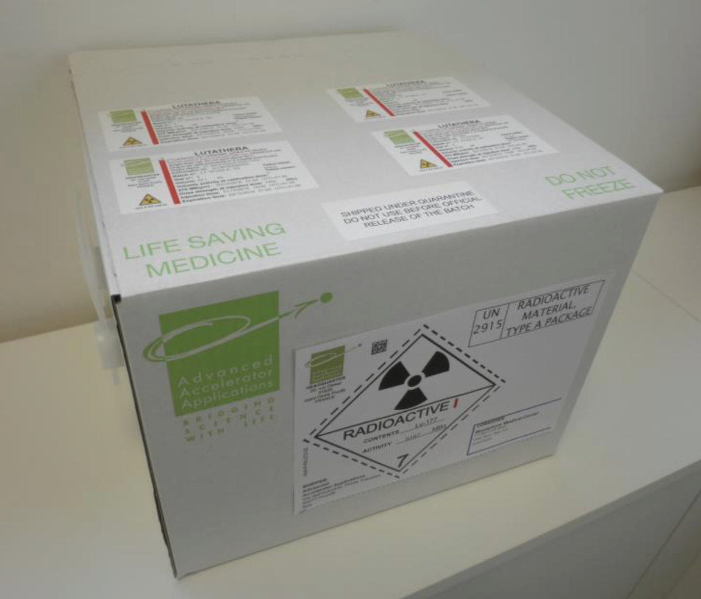
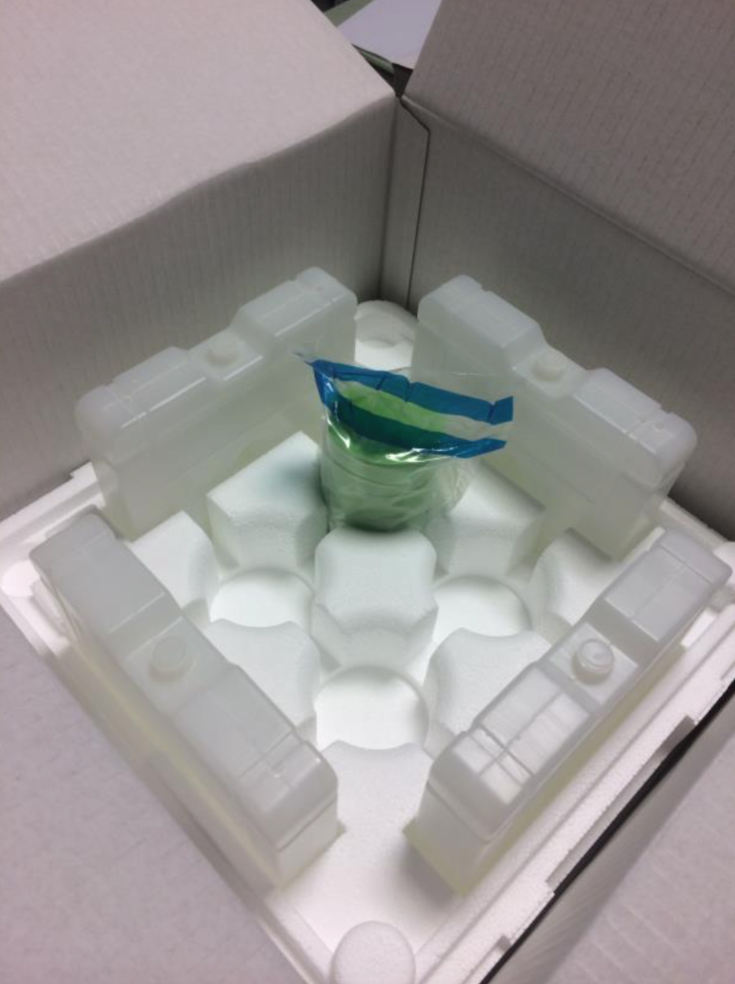
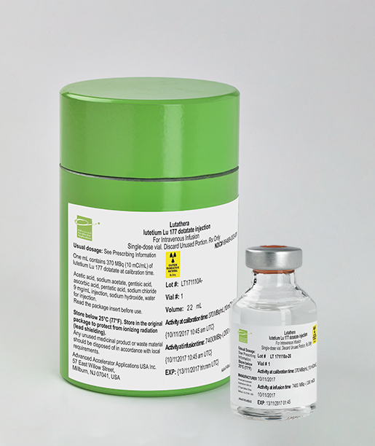
How supplied¹
Type A packaging
Plastic Sealed
LUTATHERA® is supplied as a read-to use, 30 mL single dose vial containing 200 mCi +/- 10%
Lead Container and Vial
1. LUTATHERA® [prescribing information]. Millburn, NJ: Advanced Accelerator Applications USA, Inc.; January 2018.

Slide 55
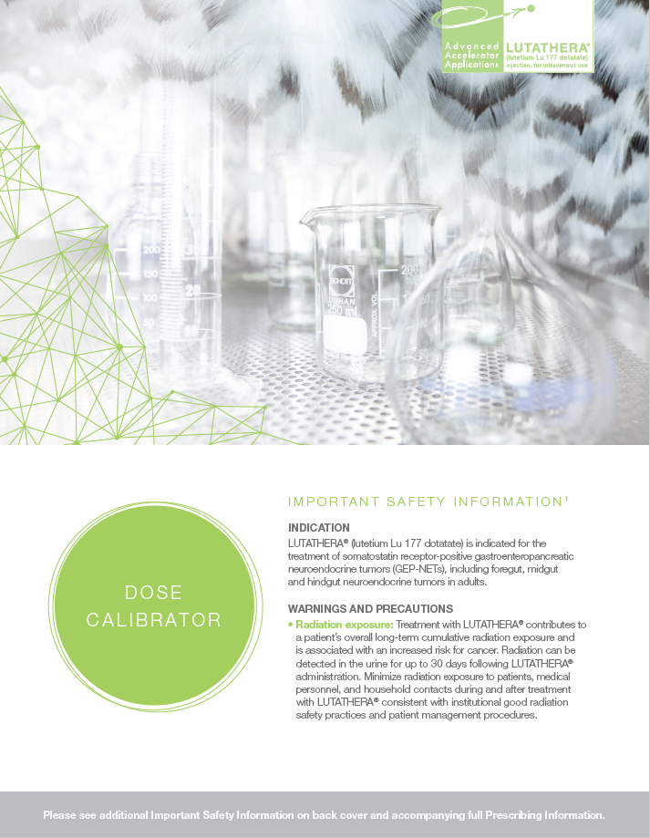
Dose calibration
A reference standard source of Lu 177 may be utilized to determine the appropriate dial setting on a dose calibrator for future use with LUTATHERA® (lutetium Lu 177 dotatate). The reference standard source of Lu 177 is measured by Advanced Accelerator Applications (AAA) at the LUTATHERA® manufacturing site and provided in a water solution or as lutetium Lu 177 dotatate (not for human use).
The reference standard will be sent:
In a 30 mL colorless Type I glass vial—the same container used to provide the patient-ready dose;
In a volume ranged between 20.5 and 25 mL;
With an activity close to 7.4 GBq (200 mCi) at date and time of clinical site calibration.

Slide 56
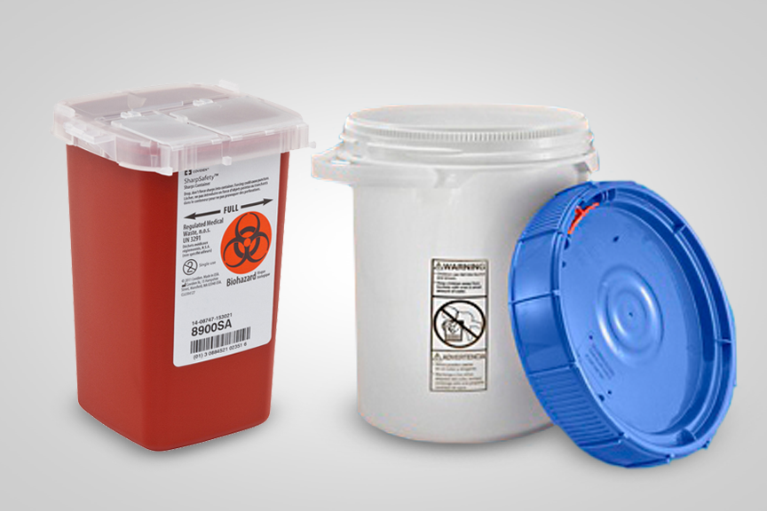
Waste management
LUTATHERA® (lutetium Lu 177 dotatate) should be disposed of only by authorized persons in designated clinical settings. LUTATHERA® is a beta emitter that decays with a half-life of ~6.647 days.¹
Materials and waste exposed to radioactivity during LUTATHERA® treatment should be stored and decayed to the appropriate allowable limits. A Waste Management Service is available, at cost, through AAA Customer Service to ship, store, and decay waste resulting from LUTATHERA® treatment. The cost associated with the Waste Management Service is approximately $1,200 per pail, which can fit around 10 LUTATHERA® administrations worth of waste materials.
To learn more about this Waste Management Service and the cost associated, please contact AAA Customer Service at customerservice-us@adacap.com.
Picture is not representative of items’ actual sizes
1. LUTATHERA® [prescribing information]. Millburn, NJ: Advanced Accelerator Applications USA, Inc.; January 2018.

Slide 57
Patient instructions
Patients may arrive in street clothes but may change into hospital gowns before the LUTATHERA® (lutetium Lu 177 dotatate) infusion, so that their gowns may be quarantined in the event of a radiation spill.
Patients should be instructed regarding procedures to avoid contamination of the bathroom:
Men should sit on the toilet to urinate
Patients should double-flush the toilet after use
Patients should be discharged only when radiation exposure to third parties does not exceed regulatory threshold; usually 5 mSv (0.5 rem)
LUTATHERA® can cause fetal harm:
Females of reproductive potential should use effective contraception during treatment and for 7 months following the final dose of LUTATHERA®.
Males with female partners of reproductive potential should use effective contraception during and for 4 months following the final dose of LUTATHERA®

Slide 58
Objectives
LUTATHERA® (lutetium Lu 177 dotatate) Important Safety Information
Gastroenteropancreatic Neuroendocrine Tumors (GEP-NETs)
LUTATHERA® Product Characteristics
Trials Supporting FDA-approval of LUTATHERA®
LUTATHERA® Regimen and Administration Procedure
Establishing LUTATHERA® at an institution
Support programs available for LUTATHERA®

Slide 59
AAA PatientCONNECT™
Copay Assistance Program*
Patient Assistance Program
Patients with commercial insurance
Patients must meet financial criteria
Uninsured patients
Patients must meet financial criteria
* Patients with public insurance (e.g. Medicare, Medicaid) do not qualify for copay assistance program
More information is available through AAA Regional Market Access Managers
Some restrictions apply. For full terms and conditions, please call AAA PatientCONNECTTM at 844-NETS-AAA. Patients who are enrolled in any type of government insurance or reimbursement programs are not eligible. As a condition precedent of the co-payment support provided under this program, e.g., copay refunds, participating patients and pharmacies are obligated to inform insurance companies and third-party payers of any benefits they receive and the value of this program, as required by contract or otherwise. Void where prohibited by law, or restricted. Patients enrolled in the AAA PatientCONNECT™ Patient Assistance Program are not eligible for Copay Assistance.

Slide 60
Summary
LUTATHERA® (lutetium Lu 177 dotatate) is a peptide receptor radionuclide therapy that selectively binds to somatostatin receptors on GEP-NETs¹
LUTATHERA® emits beta radiation that exerts a cytotoxic effect on cells¹
In a phase III trial, LUTATHERA® demonstrated a 79% reduction in the risk of disease progression or death (HR 0.21 [95% CI, 0.13, 0.32], P<0.0001)¹
In phase III trial, the most common adverse reactions lymphopenia (44%), increased GGT (20%), vomiting (7%), nausea (5%), elevated AST (5%), increased ALT (4%), hyperglycemia (4%), and hypokalemia (4%)¹
Establishing a LUTATHERA® treatment center involves multiple steps and should be planned for accordingly
1. LUTATHERA® [prescribing information]. Millburn, NJ: Advanced Accelerator Applications USA, Inc.; January 2018.

